Slide 1
Hauntology: A Poetics
an EcoTheo Workshop
Han VanderHart

Slide 2

What is hauntology?
“…the very experience of everyday life is built around a process that we can call hauntogenic, and whose major by-product is a steady stream of ghosts."
Sadeq Rahim, The Hauntology of Everyday Life
Derrida’s notion of “hauntology”: “describes a situation of temporal and ontological disjunction in which presence, especially socially and culturally, is replaced by a deferred non-origin.”
Note: this workshop is less about trapping ghosts then it is about letting ghosts in.
Ghosts arrive from the past and appear in the present. However, the ghost cannot be properly said to belong to the past.... Does then the 'historical' person who is identified with the ghost properly belong to the present? Surely not, as the idea of a return from death fractures all traditional conceptions of temporality. The temporality to which the ghost is subject is therefore paradoxical, at once they 'return' and make their apparitional debut [...] any attempt to isolate the origin of language will find its inaugural moment already dependent upon a system of linguistic differences that have been installed prior to the 'originary' moment .
Peter Buse and Andrew Scott

Slide 3
Excerpt from Jorie Graham’s “Some Notes on Silence”
I need to feel the places where the language
fails, as much as one can. Silence which is awe or astonishment, the speech ripped
out of you. All forms of death and mystery, therefore, working in each poem
against the hurry of speech, the bravery of speech. And I think it is very
important to feel the presence of that ocean in the poem, in the act of writing
the poem. Its emissaries are the white space, of course, the full stops. But, also,
all acts of grammar, which are its inroads. And the way the lines break, or slow.
I'd like to think you can feel, by its accurate failures, the forces pressing against
the sentence, the time order. And certain kinds of words, too, are messengers
of silence.

Slide 4

The Way Things Work – Jorie Graham
is by admitting
or opening away.
This is the simplest form
of current: Blue
moving through blue;
blue through purple;
the objects of desire
opening upon themselves
without us;
the objects of faith.
The way things work
is by solution,
resistance lessened or
increased and taken
advantage of.
The way things work
is that we finally believe
they are there,
common and able
to illustrate themselves.
Wheel, kinetic flow,
rising and falling water,
ingots, levers and keys,
I believe in you,
cylinder lock, pully,
lifting tackle and
Crane lift your small head—
I believe in you—
your head is the horizon to
my hand. I believe
forever in the hooks.
The way things work
is that eventually
something catches.

Slide 5

5-Minute Writing Warm Up
What is it that haunts you and your writing?
Begin by writing a list, either as prose or in lines.

Slide 6
Excerpt from M. NourbeSe Philip’s Zong! (“Notanda”)
I, too, want the bones.
I come — albeit slowly — to the understanding that Zong! is hauntological; it is a work of haunting, a wake of sorts, where the spectres of the undead make themselves present. And only in not-telling can the story be told; only in the space where it's not told—literally in the margins of the text, a sort of negative space, a space not so much of non-meaning as anti-meaning.
Our entrance to the past is through memory - either oral or written. And water. In this case salt water. Sea water. And, as the ocean appears to be the same yet is constantly in motion, affected by tidal movements, so too this memory appears stationary yet is shifting always. Repetition drives the event and the memory simultaneously, becoming a haunting, becoming spectral in its nature.
Haunted by “generations of skulls and spirits,” I want the bones.
November 2005 - Munich Airport
While waiting to make a connection, I sit and watch the flow of people and suddenly become aware that the fragment appears more precious, more beautiful than the whole, if only for its brokenness. Perhaps, the fragment allows for the imagination to complete its missing aspects - we can talk, therefore, of the poetics of fragmentation.
Re-reading Specters of Marx by Derrida has clarified some of my own thoughts and confirmed me in my earlier feelings that Zong! is a wake. It is a work that employs memory in the service of mourning - an act that could not be done before, as I've argued in an earlier essay about the possible and potential functions of memory.? Using Hamlet to interrogate the apparently defunct place and role of Marx and Marxism, Derrida asserts that we must identify the remains and localize the dead. The "work of mourning,' he writes, demands clarity: that we know who the deceased is; whose grave it is; where the grave is and that the body or bodies "remain there" - in situ. This imperative for identification, this necessity to lay the bones to rest echo the remarks of the young forensic scientist.
I feel strongly that I need to seek “permission” to bring the stories of these murdered Africans to light—above the surface of the water—to “exaqua” them from their “liquid graves.” Indeed, the stories of all the dead.

Slide 7
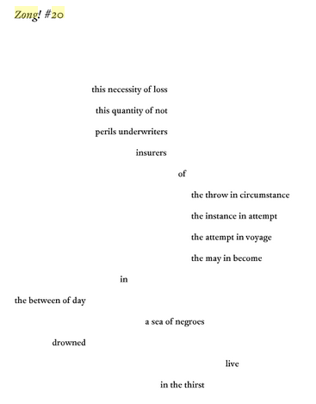
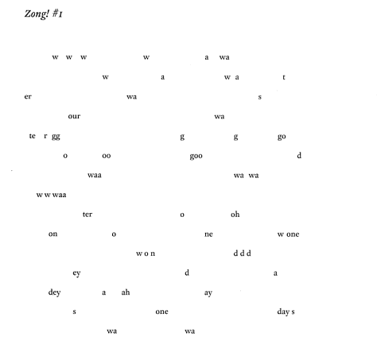
Excerpt from Zong!

Slide 8

The Blue Prompt:
Write a list of specific blues in your life OR choose a specific blue object.
All over the world—in Greek villages, in the American Southwest, among the Tuareg—blueness repels evil. Blue glass bottles on windowsills keep devils out, and so on. Thus the front door, painted spirit blue, and the vibrant blue canopies above the windows.
Louise Erdrich, The Sentence

Slide 9

The Porch or Lanai Prompt
Porch Prompt – you are sitting on a porch in a suspect/deepening light, and you see something coming towards you. What or who is it?
Note: can also do this with a rainy/steamy window if porch architecture doesn’t appeal to you or hit the right note.

Slide 10
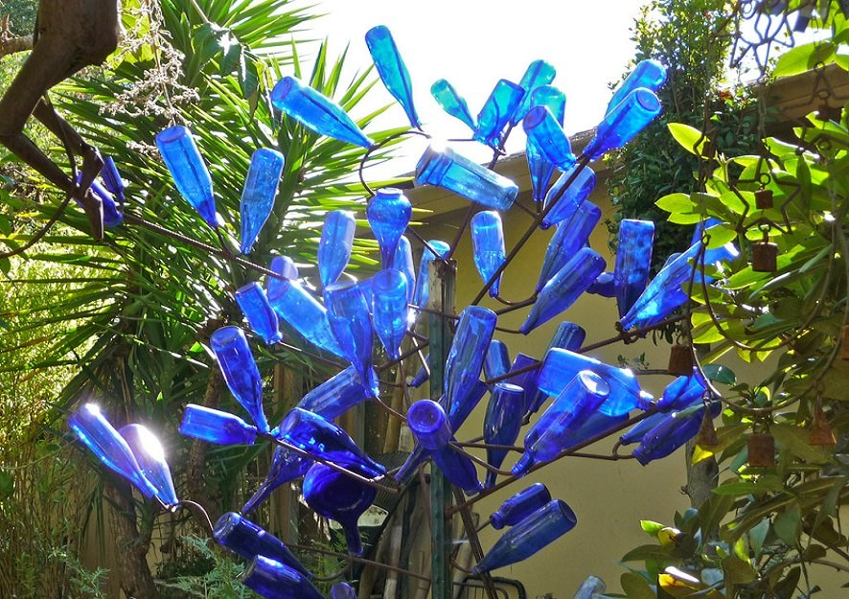
The Bottle Tree Prompt
You come into a clearing and see a tree with bottles on its branches.
Are the bottles full or empty?
Describe the tree, the bottles, the clearing, and what the bottles have (or have not) trapped.

Slide 11
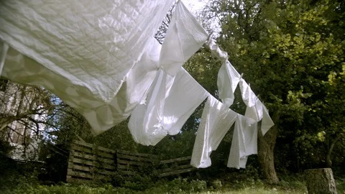
“This is a Song for Trapping a Ghost” Prompt
Using the title above (you can change it later!), write your own song or ritual for trapping a particular ghost or memory in your history.

